Slide 1
Java- Threads

Slide 2
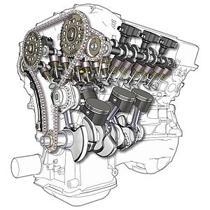

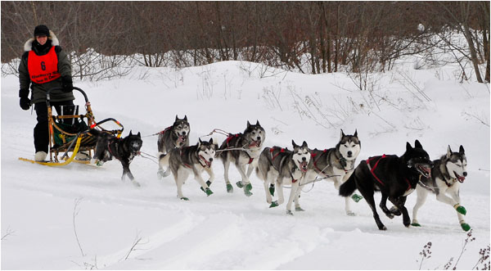



Asynchronous & Parallel
Async
Parallel
Anything else?
Notes:
Sending a Speed post. People wont be waiting till the letter is delivered at the destination. They get back a receipt and then leave. Sending letter happens in the background
Order at your grocery shop and get it delivered at home.
Online shopping.
Sleigh and many dogs. They can pull a bigger load
V6 engine – More throttles working together and hence more power output
Multiple queues in Walmart – Faster movement of billing queues

Slide 3
Threads
A thread is a single sequence of execution within a program
E.g. Main method
A Thread can spawn new threads from within
Can be implemented either by
Extending “java.lang.Thread”
Implementing “java.lang.Runnable”
Let’s see
an Example
Observations
Runnable requires a thread to execute. So why do we need a Runnable ?
Every execution can lead to a different order in which the threads are executed.
The Main thread finished execution, with the child threads still running.
Notes:
For example refer Threads/example1
Runnable is required in event the thread implementation needs to extend from another class.

Slide 4




Types of Threads
 | User Threads | Daemon Threads
 | High Priority | Low Priority
 | JVM lives until completion | JVM terminates even if alive
 | Foreground Process | Background Process
 | main() thread | Garbage Collector

Slide 5

Computations in Threads
We can pass arguments to a thread by declaring fields in the thread class
Try this !
For a List of String array, calculate and print the lengths of individual strings, in separate threads.
Let’s see
an Example
Notes:
For example refer Threads/example2

Slide 6


Aggregation using Threads
A big process may be desired to be split into smaller processes
Results from the smaller process are aggregated to provide a single result
Try this !
From a list of Strings, find the number of occurrences of the letter “A”
Let’s see
an Example
Notes:
For example refer Threads/example3
Demonstrate the concept of thread.join()

Slide 7


Sharing resources between Threads
Multiple threads may share a common object, reading/ modifying it
Can lead to inconsistent reads and writes. The integrity of data will be lost
Try this !
From a list of Strings, find the number of occurrences of the letter “A”
Let’s see
an Example
Notes:
We talk about synchronization in this slide and show how we synchronize block in the run method

